Slide 1
第二章 线性回归

Slide 2
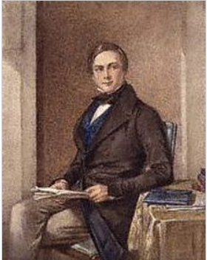
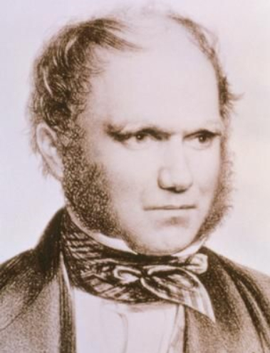
Linear Regression model

Slide 3
Linear Regression model
If a regression model has only two unknown parameters, then it is a binary regression model
If there are more than two parameters, then it is a multiple regression model
BINARY REGRESSION MODEL
A binary regression model takes the form:
y_{i} = β_{o} + β₁x_{1i} + ε_{i}
where y = dependent variable
x = one explanatory variable
β_{o} and β₁ = parameters to be estimated
ε = random error or disturbance
In order to estimate parameters, specific assumptions regarding the probability distribution of ε must be made. These assumptions are very basic to any statistical regression analysis:

Slide 4

Assumptions of Linear Regression models
Assumptions 1:
Continuous Dependent Variable Y
Y -- Count variables: Poisson and negative binomial regression
Y -- Nominal scale variables: Discrete outcome models
Y -- Ordered scale variables: Ordered regression models
Assumptions 2:
Linear-in-Parameters Relationship between Y and X
y_{i} = β₀ + β₁x_{1i} + ε_{i}

Slide 5
Assumptions of Linear Regression models
Assumptions 3:
Observations Independently and Randomly Sampled
Independence requires that the probability that an observation is selected is unaffected by other observations selected into the sample.
Other sampling schemes such as stratified and cluster samples can be accommodated in the regression modeling framework with corrective measures

Slide 6

Assumptions of Linear Regression models
Assumptions 4:
Uncertain Relationship between Variables
Variables that were omitted from the model
Measurement errors in the dependent variable, or the imprecision in measuring Y.
Random variation inherent in the underlying data-generating process.

Slide 7
Least Squares Estimation
In the figure, the vertical line segments represent deviations of the observation points from the line. One can find many lines for the sum of deviations (errors) is equal to zero. But it can be shown that there is one and only one line for which the SUM of SQUARED DEVIATIONS is a minimum. This sum is called the sum of squared errors (SSE).
y
y = β_{o} + β₁ x + ε
Deviations (errors)
x

Slide 8
Least Squares Estimation
y
y = β_{o} + β₁ x + ε
Deviations (errors)
x
Thus, is an estimator of the mean value of y, E(y), and a predictor of some future value of y. are least squares estimators of β_{o} and β₁ respectively.
For a given data point, (x_{i}, y_{i}), the observed value of y is y_{i} and the predicted value of y would be obtained by substituting x_{i} into the prediction equation:

Slide 9
Least Squares Estimation
y
y = β_{o} + β₁ x + ε
Deviations (errors)
x
The deviation of the ith value of y from its predicted value is:
Then, the sum of squares of the deviations of the y values about their predicted values for all of the observations (n data points):

Slide 10
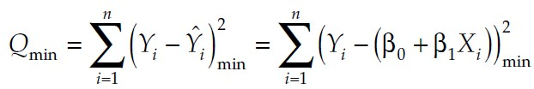

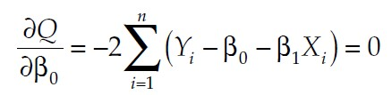
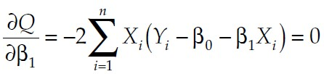
Least Squares Estimation
OLS seeks a solution that minimizes the function Q:
By setting the partial derivatives of Q with respect to β_{o} and β₁ 􀀕 equal to zero, the least squares estimated parameters β_{o} and β₁ are obtained:

Slide 11
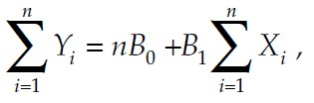

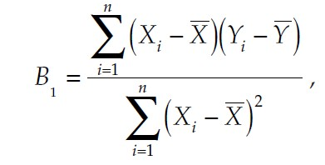
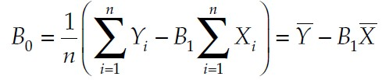
Least Squares Estimation
Solving these equations using B₀ and B₁ to denote the estimates of β_{o} and β₁ , respectively, and rearranging terms yields:
Solving simultaneously for the betas yields:

Slide 12
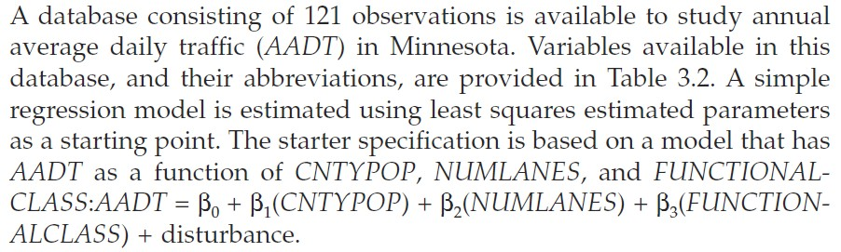
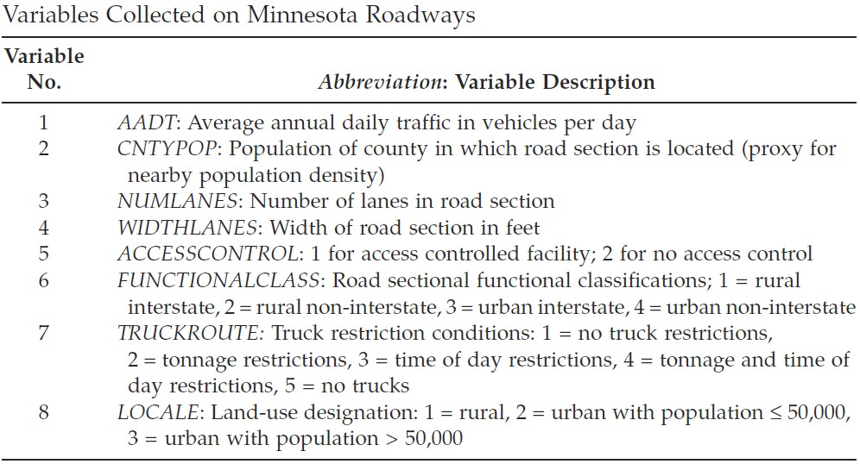
Least Squares Estimation

Slide 13
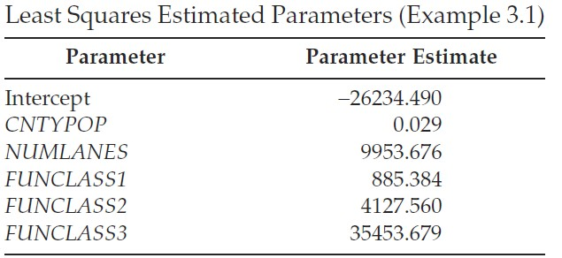
Least Squares Estimation
For each additional 1000 people in the local county population, there is an estimated 29 additional AADT.
For each lane there is an estimated 9954 AADT.
Urban interstates are associated with an estimated 35,454 AADT more than non-interstates

Slide 14

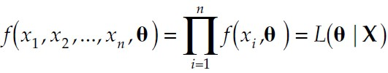
Maximum Likelihood Estimation
Another popular and sometimes useful statistical estimation method is called maximum likelihood estimation, which results in the maximum likelihood estimates, or MLEs. The probability of each observation is given as:
Likelihood function is the joint density of observing the sample data from a statistical distribution with parameter vector

Slide 15


Maximum Likelihood Estimation
For the regression model, the likelihood function for a sample of n independent, identically, and normally distributed disturbances is given by:
As is usually the case, the logarithm of Equation, or the log likelihood, is simpler to solve than the likelihood function itself, so taking the log of L yields:

Slide 16
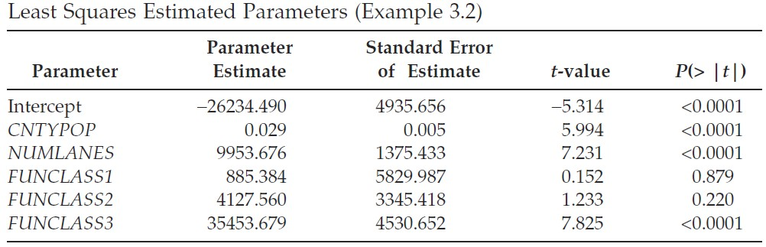
Inference in Regression Analysis
Consider again the study of AADT in Minnesota. Interest centers on the development of confidence intervals and hypothesis tests on some of the parameters estimated in Example 3.1

Slide 17
Manipulating Variables in Regression
Standardized regression models allow for direct comparison of the relative importance of independent variables
Often interest is focused on the relative impacts of independent variables on the response variable Y
Two independent variables in a model describing the expected number of daily trip-chains were number of children and household income
Households may have children ranging from 0 to 8, while income may range from $5000 to $500,000, making it difficult to make a useful comparison between the relative impact of these variables

Slide 18

Manipulating Variables in Regression
The standardized regression model is obtained by standardizing all independent variables.
The standardized variables are created with expected values equal to 0 and variances equal to 1.

Slide 19




Manipulating Variables in Regression
Nonlinear relationships can be accommodated within the linear regression framework by Transformations

Slide 20
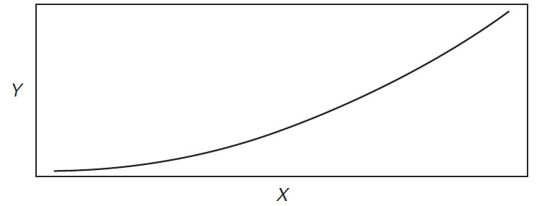
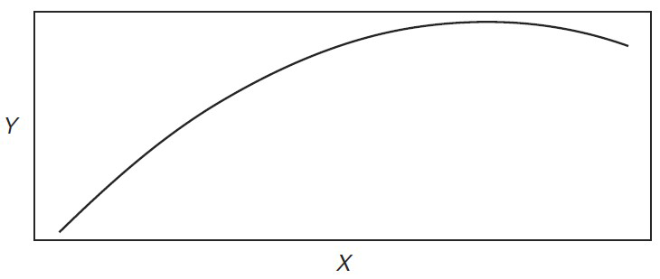
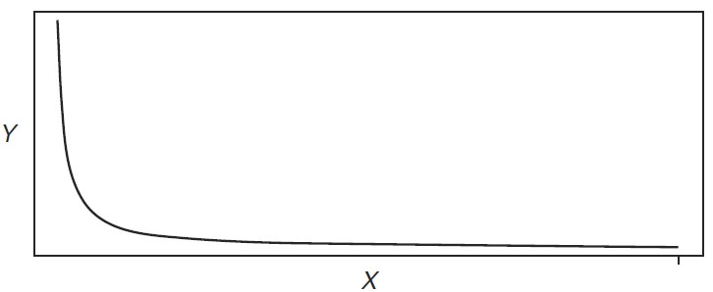
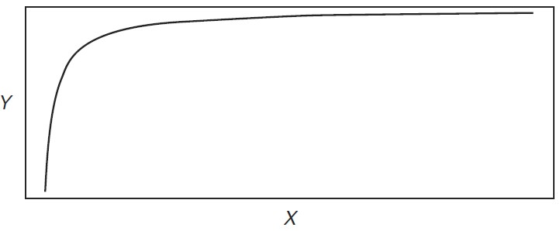

Manipulating Variables in Regression

Slide 21
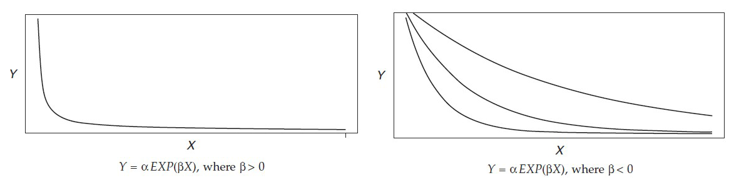
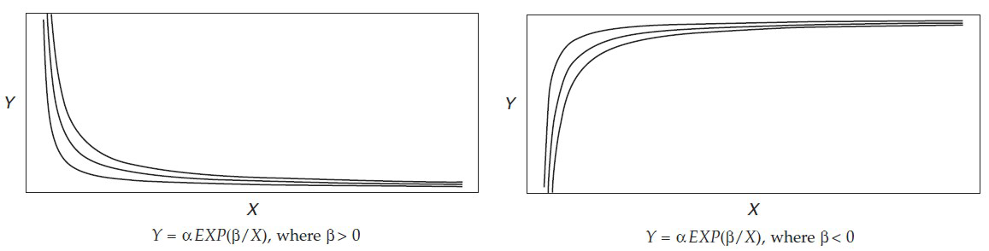
Manipulating Variables in Regression

Slide 22
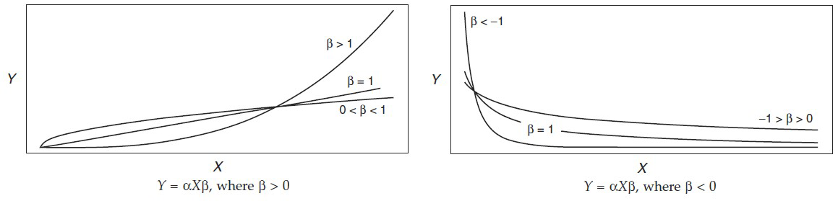
Manipulating Variables in Regression

Slide 23
Manipulating Variables in Regression
Nominal scale variables need transformed into indicator Variables
Qualitative variables such as roadway functional class, gender, attitude toward transit, and trip purpose
For nominal scale variables, m-1 indicator variables must be created to represent all m levels of the variable in the regression model.

Slide 24
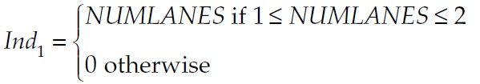
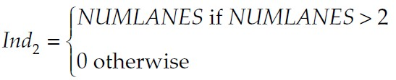
Manipulating Variables in Regression
Estimate a Single Beta Parameter: The assumption in this approach is that the marginal effect is equivalent across increasing levels of the variable
Estimate Beta Parameter for Ranges of the Variable: Consider the variable NUMLANES used in previous chapter examples. Although the intervals between levels of this variable are equivalent, it may be believed that a fundamentally different effect on AADT exists for different levels of NUMLANES.
These two indicator variables would allow the estimation of two parameters, one for the lower range of the variable NUMLANES and one for the upper range

Slide 25
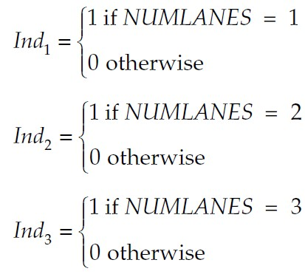
Manipulating Variables in Regression
Estimate a Single Beta Parameter for m-1 of the m Levels of the Variable: The justification for this approach is that each level of the variable has a unique marginal effect on the response

Slide 26


Manipulating Variables in Regression
汽车=1 — 参考等级
X2 步行=2
X3 自行车=3
X4 公交=4
Interactions in regression models represent a combined or synergistic effect of two or more variables. That is, the response variable depends on the joint values of two or more variables.

Slide 27
Manipulating Variables in Regression
Depending on which of the indicator variables is coded as 1, the slope of the regression line with respect to X1 remains fixed, while the Y-intercept parameter changes by the amount of the parameter of the indicator variable.

Slide 28
Manipulating Variables in Regression
Suppose that each indicator variable is thought to interact with the variable X1. That is, each level of the indicator variable has a unique effect on Y when interacted with X1.

Slide 29
Manipulating Variables in Regression
Each level of the indicator variable now has an effect on both the Y-intercept and slope of the regression function with respect to the variable X1.

Slide 30
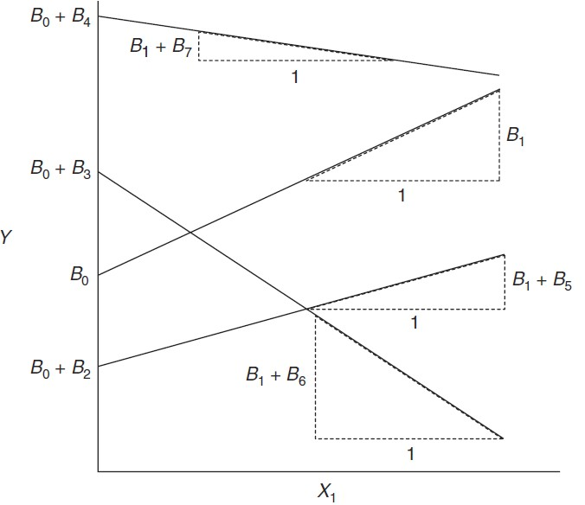
Manipulating Variables in Regression

Slide 31

Manipulating Variables in Regression
When interactions are between two or more continuous variables the regression equation becomes more complicated.
The regression function indicates that the relationship between X₁ and Y is dependent on the value of X₂, and conversely, that the relation between X₂ and Y is dependent on the value of X₁.
There are numerous cases when the effect of one variable on Y depends on the value of one or more independent variables.
Although they may not explain a great deal of the variability in the response, they may represent important theoretical aspects of the relation and should be included in the regression.

Slide 32

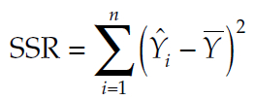
Model Goodness-of-Fit Measures
GOF: R-squared, and adjusted R-squared.
To develop the R-squared GOF statistic, some basic notions are required:
The sum of square errors (disturbances) is given by:
the regression sum of squares is given by

Slide 33


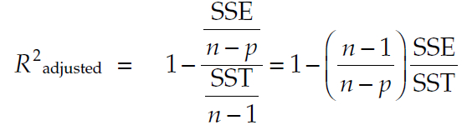
Model Goodness-of-Fit Measures
The total sum of squares is given by
It also can be shown algebraically that SST = SSR + SSE.
The coefficient of determination, R-squared, is defined as
The coefficient of determination, R-squared, is defined as

Slide 34
Model Goodness-of-Fit Measures
The R² and R²_{adjusted} measures provide only relevant comparisons with previous models that have been estimated on the phenomenon under investigation
The absolute values of R² and R² adjusted measures are not sufficient measures to judge the quality of a model.
Relatively large values of R² and R² adjusted can be caused by data artifacts.
The R² value is 0.8947. The collection of independent variables accounts for about 89% of the uncertainty or variation in AADT.
This is considered to be a good result because previous studies have achieved R-squared values of around 70%. It is only with respect to other models on the same phenomenon that R-squared comparisons are meaningful.

